Slide 1

I.D.A.__Intelligent Digital Assistant
---AN AI FOR PERSONAL AND PROFESSIONAL USE
UNDER THE GUIDANCE OF
MANJUBALA.C
M.TECH
MADE BY
MATHUSOOTHANAN K

Slide 2
ABSTRACT
It is a virtual assistant technology . Voice assistants like (Alexa, Siri, Google, Cortana) start to be widely used, and their functionalities keep growing. Knowing how to develop apps for voice assistants is a competence that can be very demanded in the near future. The techniques required are different to those used when developing for traditional devices (computers and smartphones). The way the users interact with a voice assistant is very different to the use of keyboard-mouse combinations.

Slide 3
INTRODUCTION
Today the development of artificial intelligence (AI) systems that can organize a natural human-machine interaction (through voice, communication, gestures, facial expressions, etc.) are gaining in popularity. One of the most studied and popular was the direction of interaction, based on the understanding of the machine by the machine of the natural human language. It is no longer a human who learns to communicate with a machine, but a machine learns to communicate with a human, exploring his actions, habits, behaviour and trying to become his personalized assistant.

Slide 4
This system is designed to be used efficiently on desktops. Personal assistants software improves user productivity by managing routine tasks of the user and by providing information from an online source to the user.
This project was started on the premise that there is a sufficient amount of openly available data and information on the web that can be utilized to build a virtual assistant that has access to making intelligent decisions for routine user activities.
Keywords: Virtual Assistant Using Python, AI, Digital assistance, Virtual Assistance, Python

Slide 5
LANGUAGES AND FILES USED
PYTHON
SPEECH
RECOGNITION
PYTTSX3
PYAUDIO
AND
etc

Slide 6
HARDWARE REQUIREMENTS
Intel Pentium or and processors with speed minimum T4300,(2.10Ghz)
Minimum 4 GB RAM.
Accelerated graphics card.
Minimum 1GB hard disk
Better performance with 2.10ghz and above cache memory
Monitor : 15’’ LED
Input Devices : Keyboard, Mouse

Slide 7
SOFTWARE REQUIREMENTS
Operating System : Windows 10
Web Development Platform : ASP . NET
Back-end : Microsoft Access
Browser : Google Chrome

Slide 8
FEATURES
This AI has some unique feature that are not present in well knowned AI’s like alexa, siri, and google.
Our AI is specially made for dumb peoples because they can’t speak but they can hear
the voice of the AI and we thinked about it lot.
So we add a feature that can able to reply through voice even though they use the text option to search and that is a major thing missing in the other AI.
A point to remember this AI is not only for dumb peoples because it can able to recognize your voice And reply through voice respectively so you can use voice also for search.

Slide 9
USES OF THIS AI
We can use it for office usage for finding bills , attendance [ID] ,and see an employer’s information (or) student information . It is capable of voice interaction, music playback ,streaming podcasts, show books, and sports news, and other real-time information, such as news. If we give a some of instruction example : “ open a ‘file name’ ‘given name of AI ‘ then it open system file to search and find out our informations .

Slide 10
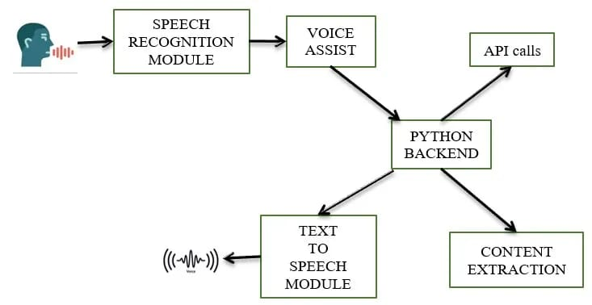
HOW IT WORKS THROUGH SPEECH

Slide 11
APPLICATIONS AND ADVANTAGES
The project aim is to create an artificial intelligence software.
To simplicity of the work of others.
We can instruct an instruction through voice OR TEXT in the terminal of the (VISUAL STUDIO).
It will be integrated with the Internet.
This Artificial intelligence can say jokes, Search an Information about specific person. It can able to play music with the support of browser

Slide 12
THANKYOU!
THANKING YOU

